Slide 1
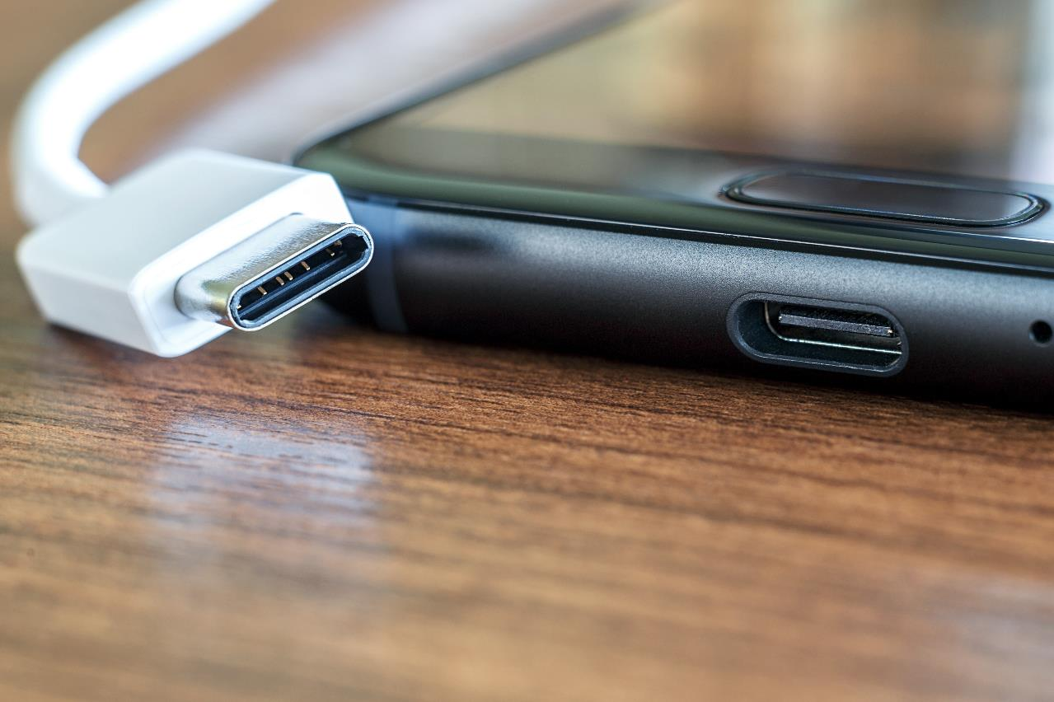
Littelfuse SP33R6-04UTG: 12kV TVS Diode Array for Ultra High Speed Interfaces
Americas Components

Slide 2
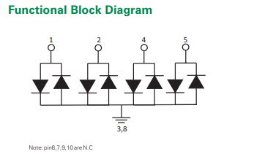
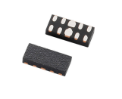

OVERVIEW
The new SP33R6 is a series of four-channel, low capacitance (0.2pF) TVS diode arrays. These robust diodes provide extremely low breakdown/turn-on voltages, making them ideal protectors of high-speed data lines with low voltage (-0.3 to +0.3V).
Without performance degradation, they can safely absorb repetitive ESD strikes above the maximum level specified in IEC 61000-4-2 international standard (Level 4, ±8kV contact discharge).
FEATURES
BENEFITS
Low capacitance of 0.2pF (TYP) per I/O
ESD, IEC 61000-4-2, ±12kV contact, ±15kV air
EFT, IEC 61000-4-4, 40A (5/50ns)
Lightning, 3A (8/20μs as defined in IEC 61000-4-5, 2nd Edition)
Halogen free, lead free and RoHS compliant
Compliant with numerous IEC standards for ESD suppression and lightning surge protection
Four channels with low capacitance to protect ultra-high-speed interfaces
An environmentally friendly component that is halogen-free, lead-free, and RoHS compliant.

Slide 3




MECHANICAL & ELECTRICAL PERFORMANCE
TARGET MARKETS & APPLICATIONS
Provides exceptional protection for electronics used in appliances, building automation, outdoor lighting, and smart meter applications.
Ideal for: USB 3.2, USB 4.0, Thunderbolt 3.0, PCIE
ESD Withstand Voltage (Contact) ±12kV
ESD Withstand Voltage (Air) ±15kV
Line Capacitance (f=3GHz) 0.2pF
Peak Current (tp=8/20μs) 3A
Reverse Standoff Voltage (IR=1uA) 0.3V
Breakdown Voltage (IR=1mA) 0.6V to 0.9V
Reverse Leakage Current (VR=0.3V) 100nA
Clamp Voltage (IPP=1A, TP=8/20us) 2.5V
Clamp Voltage (IPP=2A, TP=8/20us) 3.3V
Dynamic Resistance (tp=100ns) 0.3Ohms
Operating Temperature -40°C to 125°C
Datasheet: Link
Part Number | Description | Package
SP33R6-04UTG | 0.2pF, 12kV, 0.6V | μDFN-10

